Slide 1
Week1

Slide 2
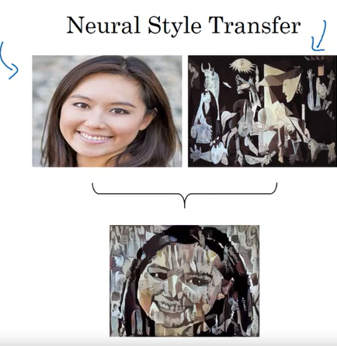

Slide 3
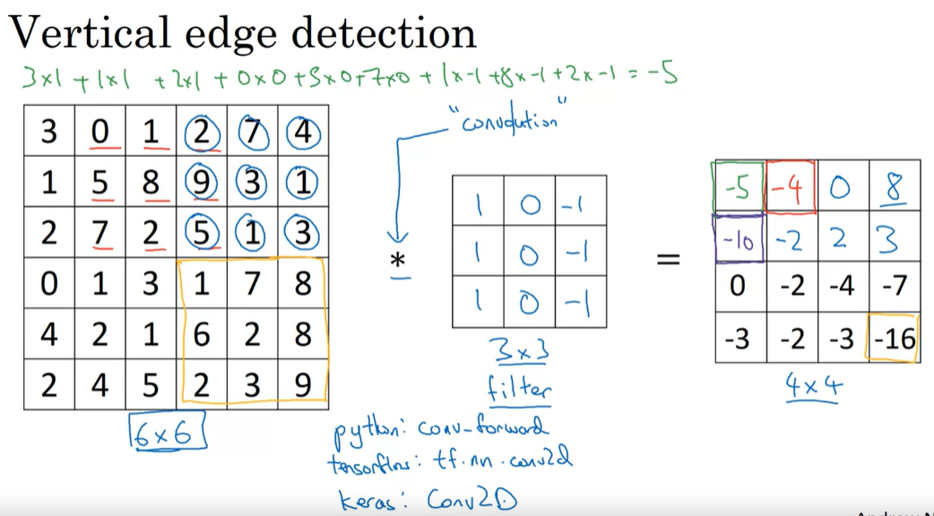

Slide 4
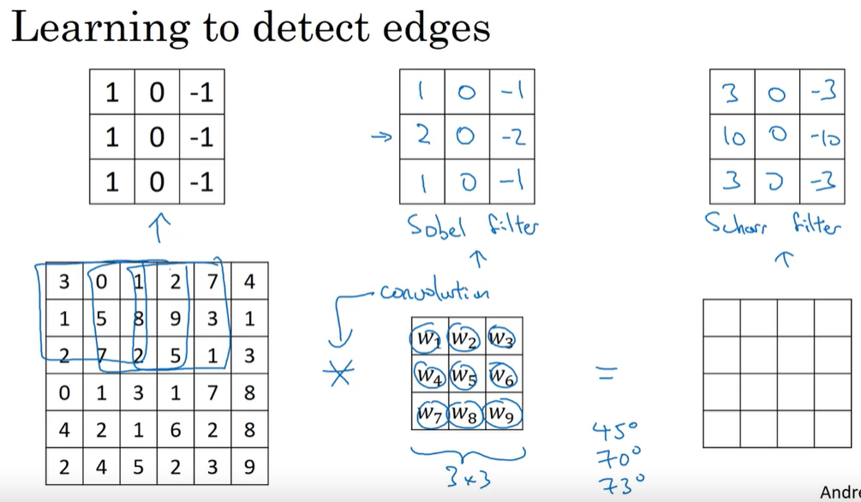

Slide 5
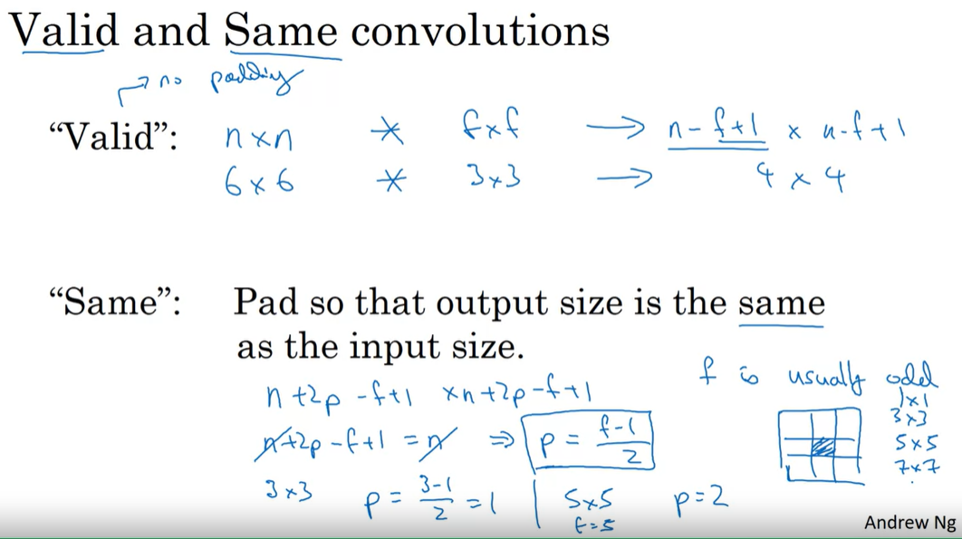





Slide 6
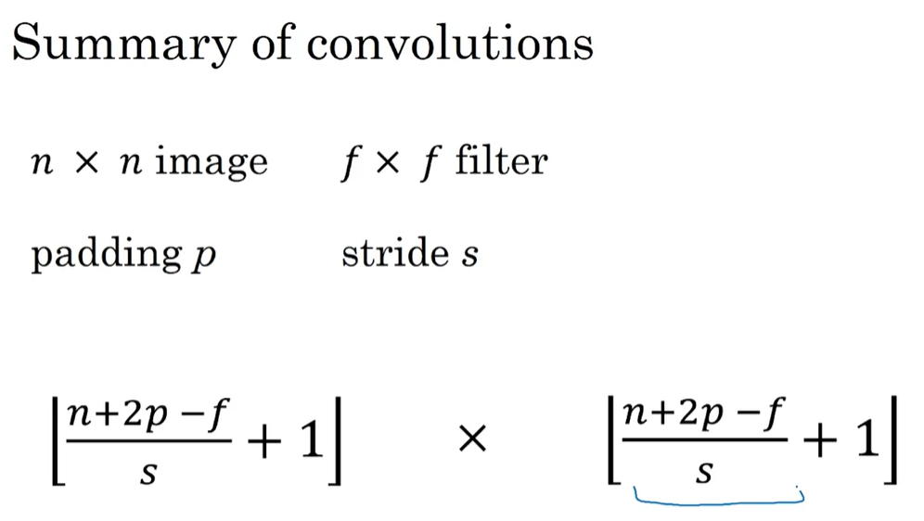

Slide 7
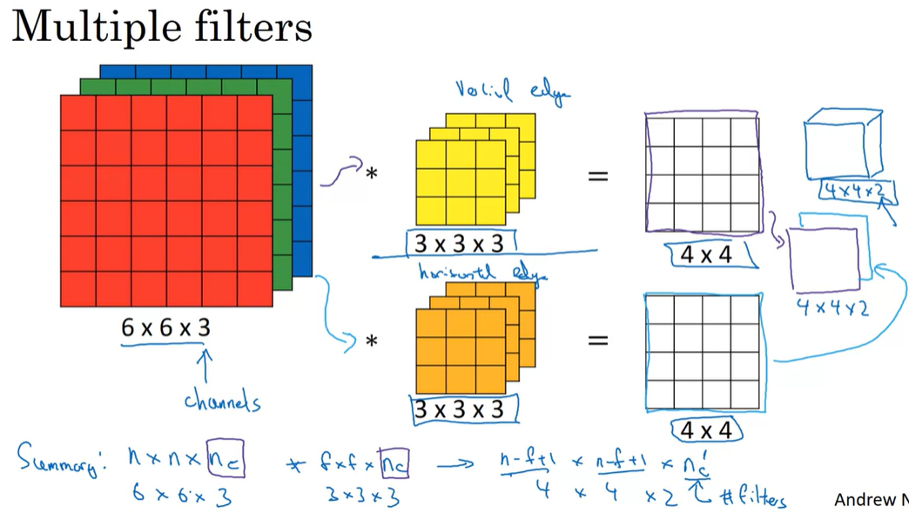

Slide 8
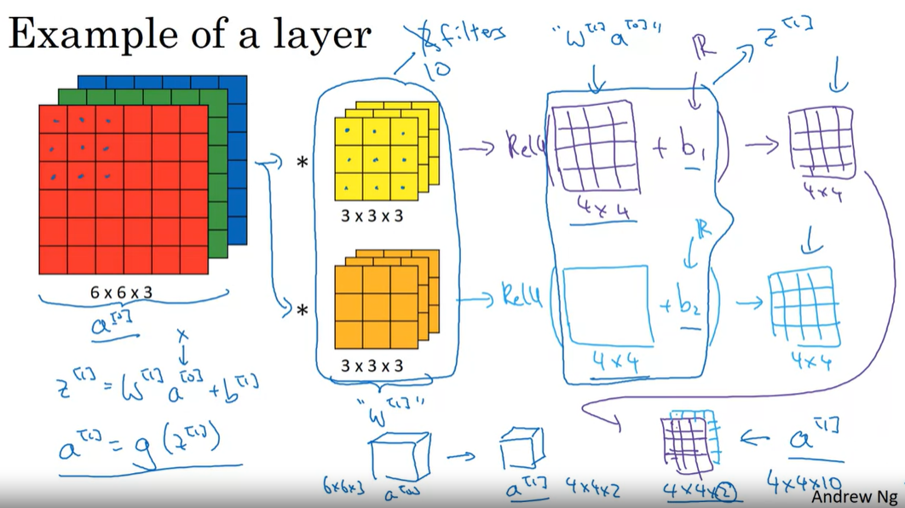

Slide 9
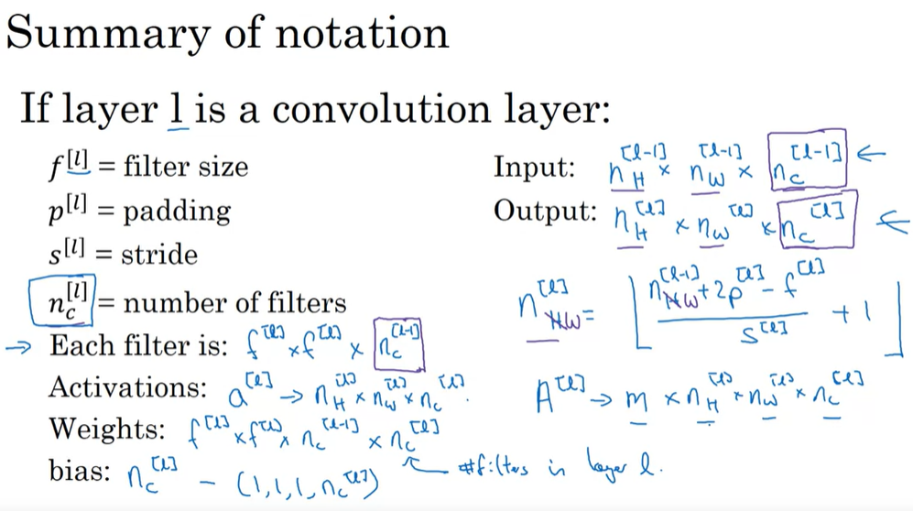



Slide 10
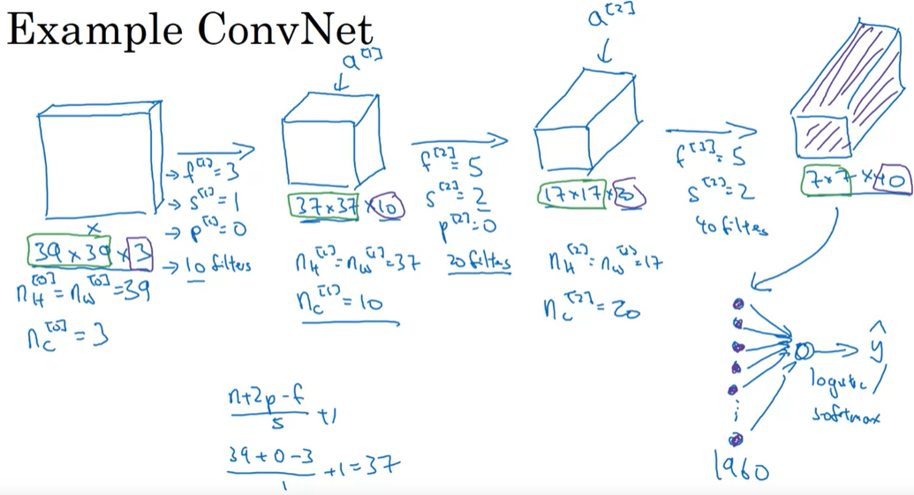

Slide 11
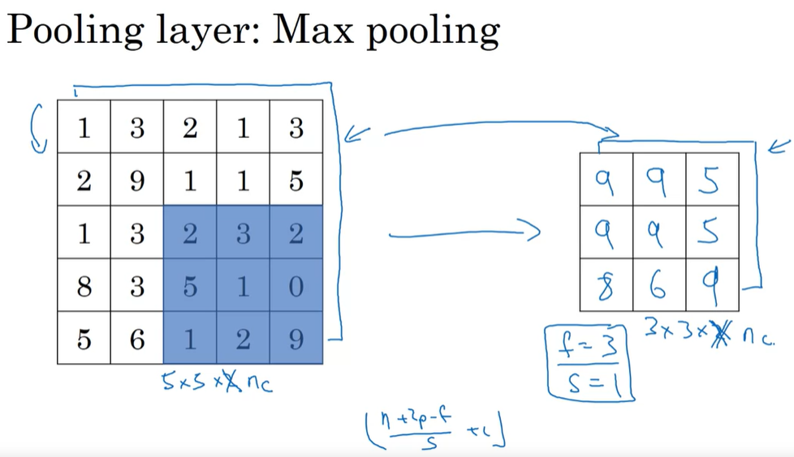
Note that the number of output channel stays the same, (not bring down to 1 as in normal conv operation

Slide 12
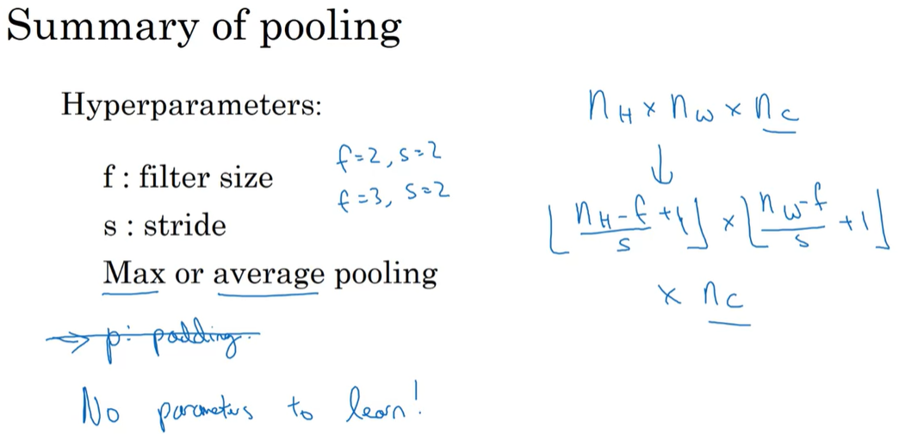

Slide 13
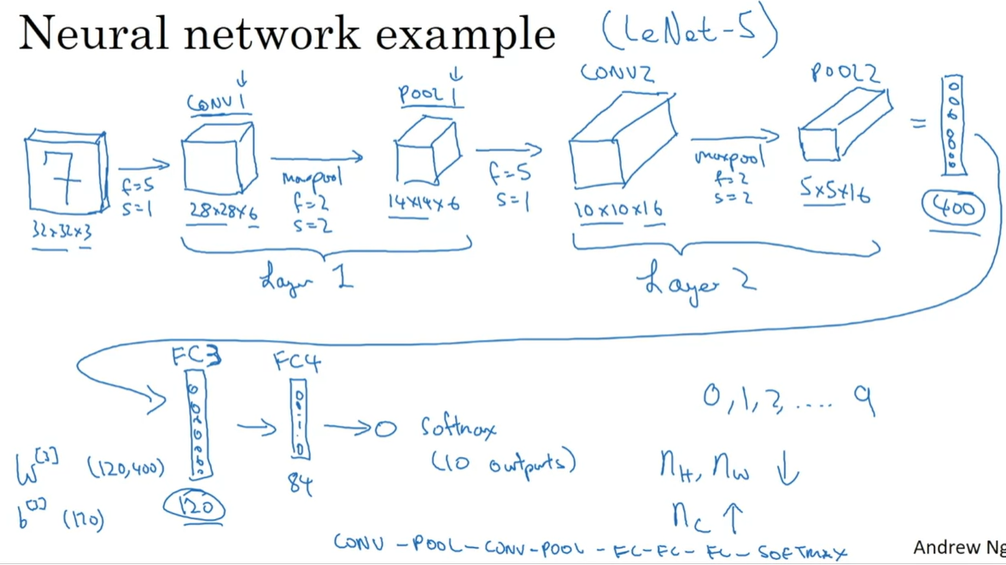

Slide 14
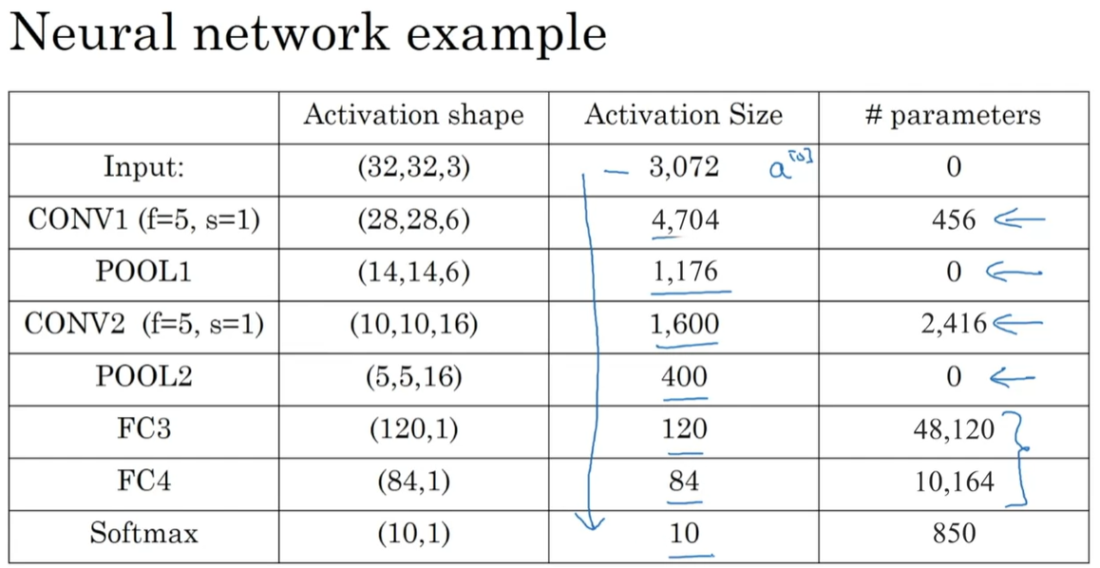
(filter_height * filter_width * input_channels + 1) * number_of_filters

Slide 15
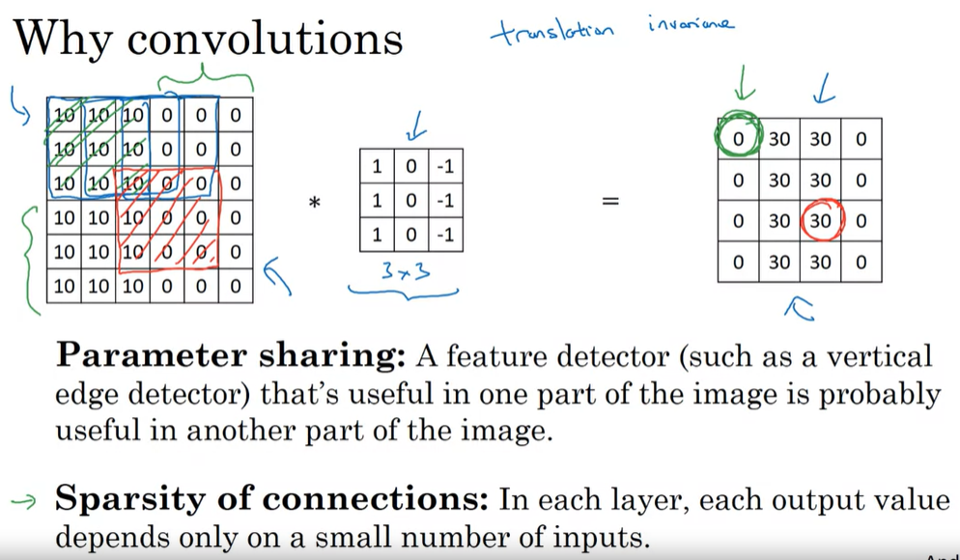

Slide 16
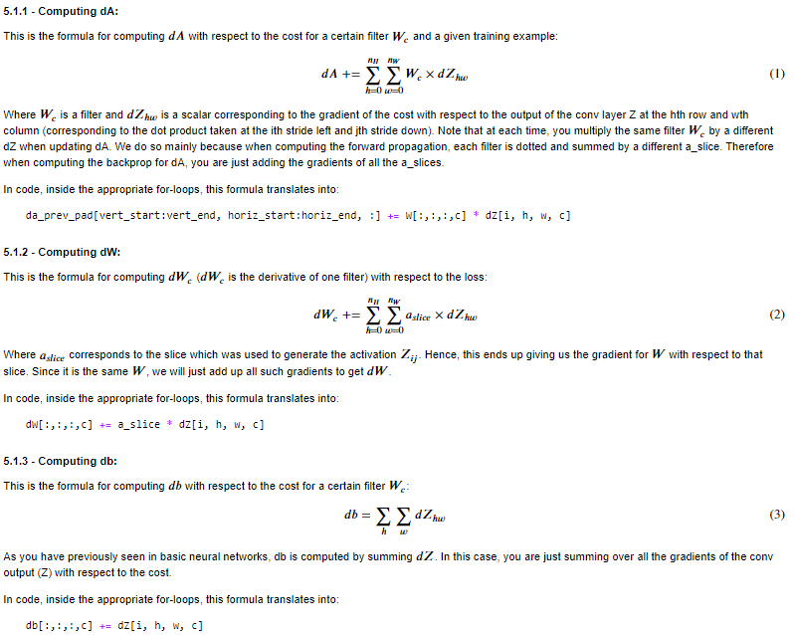
Back Prop of Conv Layer
Note that index is moving
dZ --> dW,db, and dA
Because:
a_slice * W_c = z_hw
Therefore:
da_slice = W_c * dz_hw
dW_c = a_slice * dz_hw

Slide 17
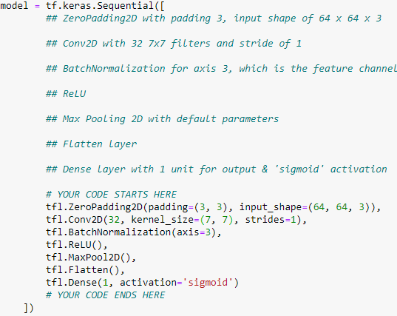
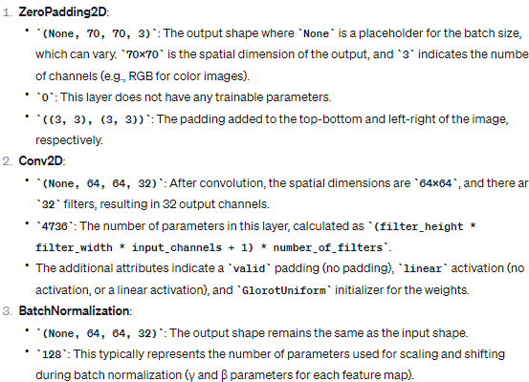
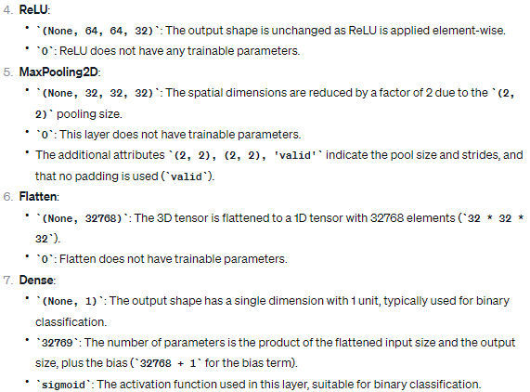
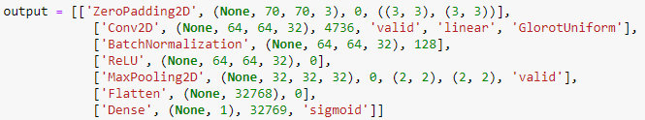
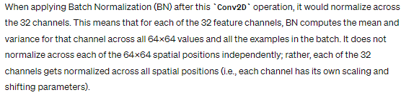
BN is done on each feature channel!

Slide 18
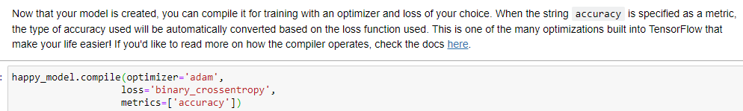
Binary accuracy will be used as binary_crossentropy is selected as the loss function

Slide 19
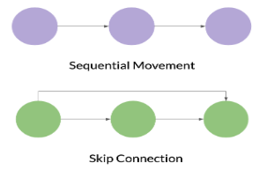
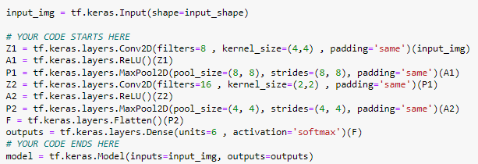
Where Sequential is a straight line, a Functional model is a graph, where the nodes of the layers can connect in many more ways than one.

Slide 20
Week 2 Case Studies

Slide 21
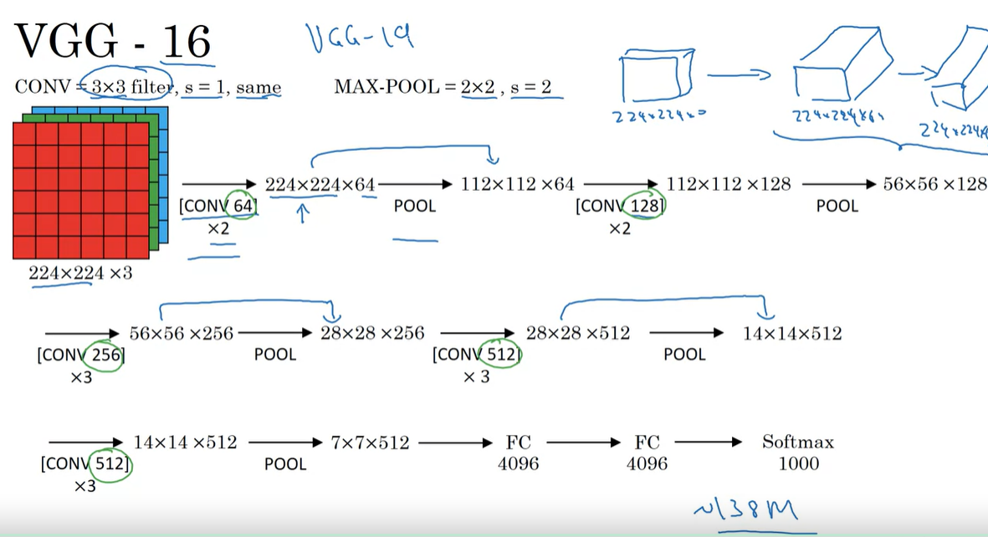
Layers

Slide 22
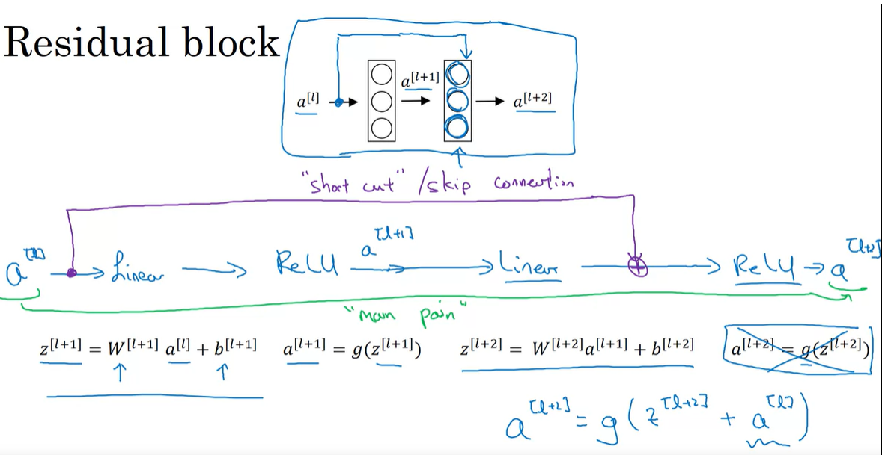
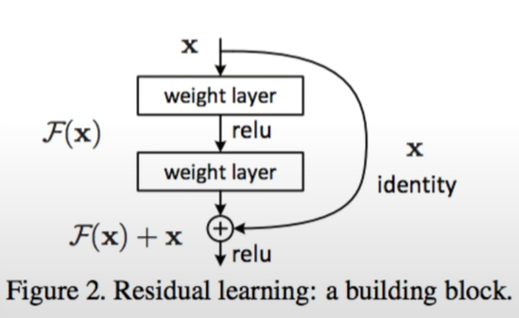

Slide 23
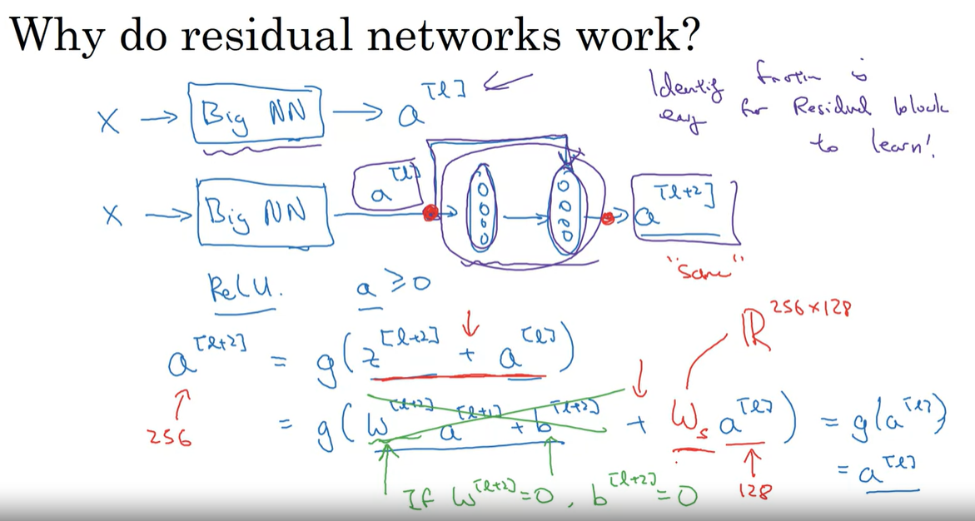

Slide 24
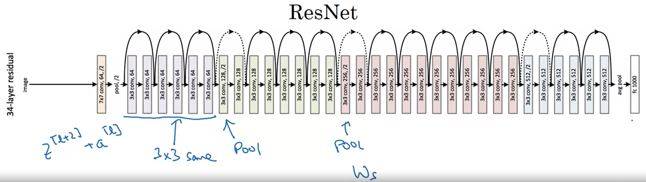
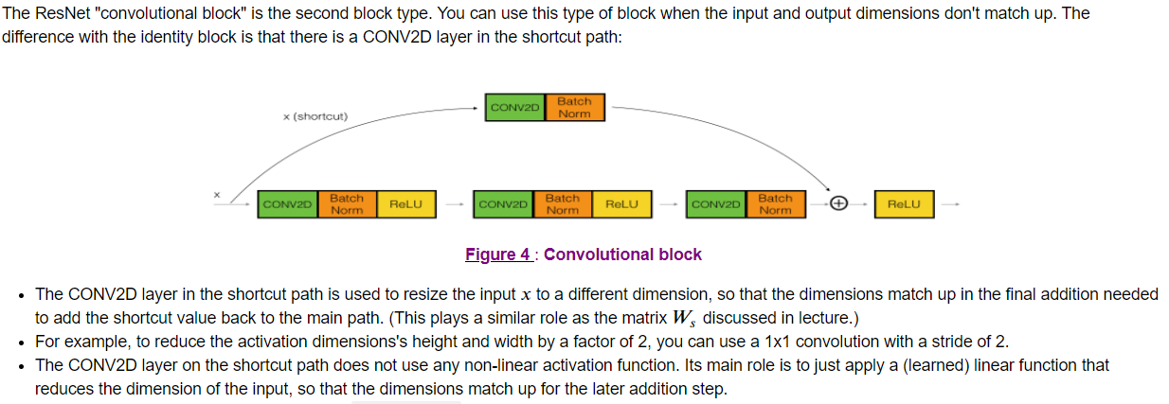
Deal with dimension(channel) inconsistency? Add a conv2d layer!

Slide 25
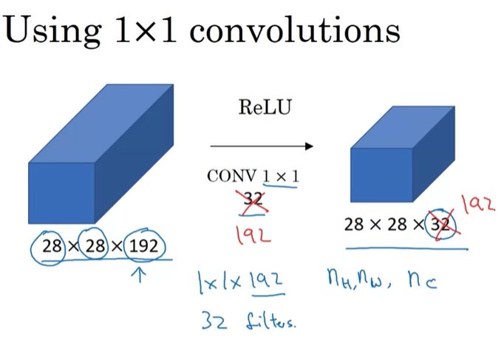
Manipulate the number of channels
Reduce number of channel → Reducing cost

Slide 26
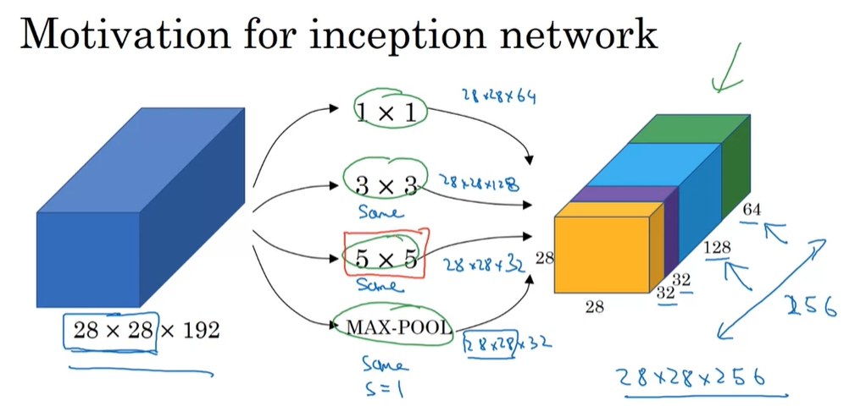

Slide 27
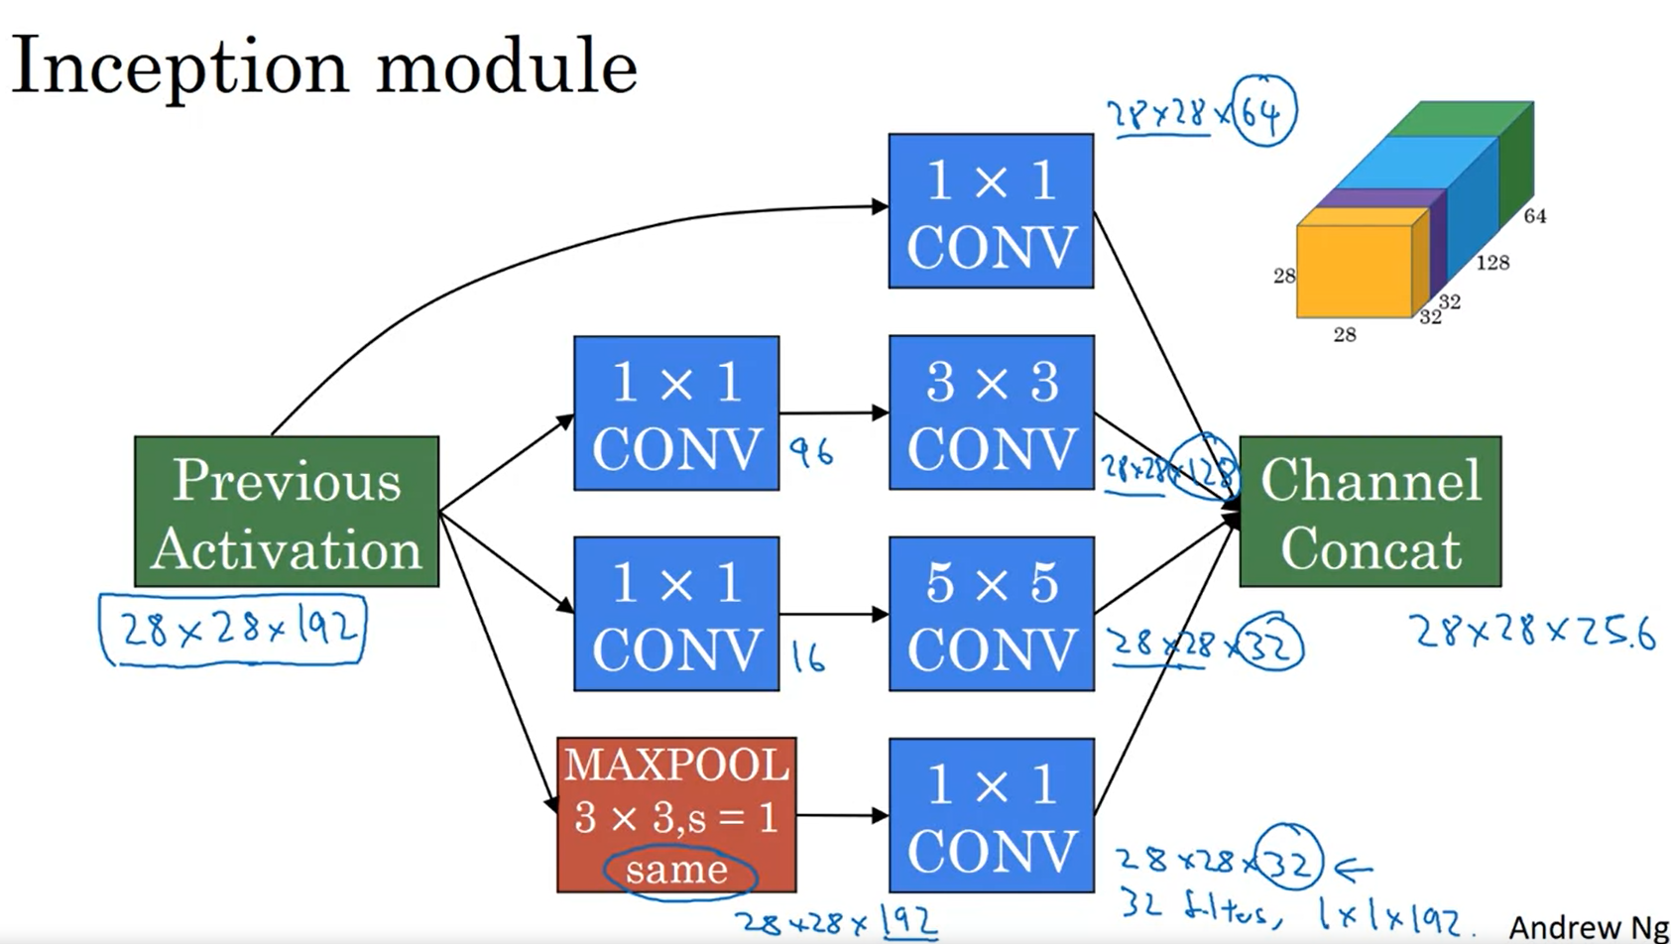

Slide 28
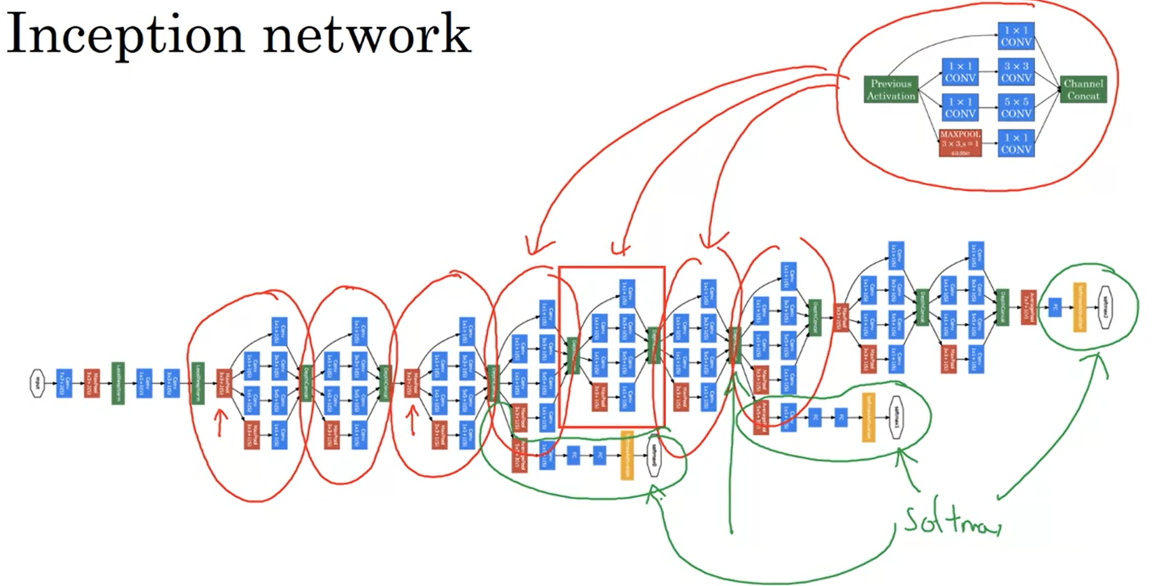

Slide 29
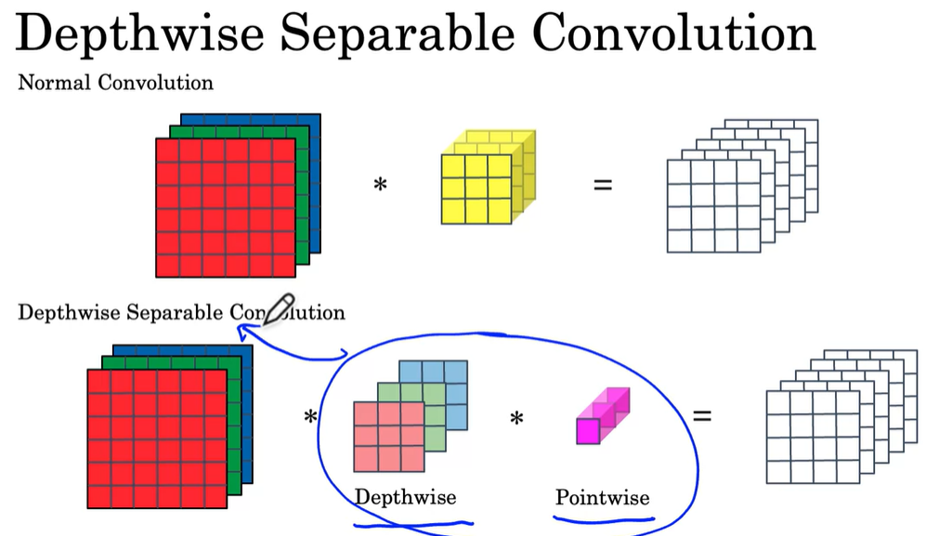

Slide 30
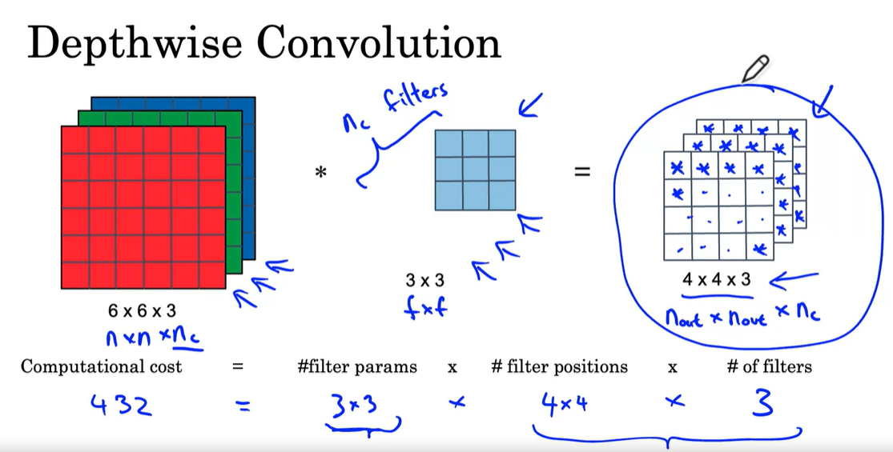
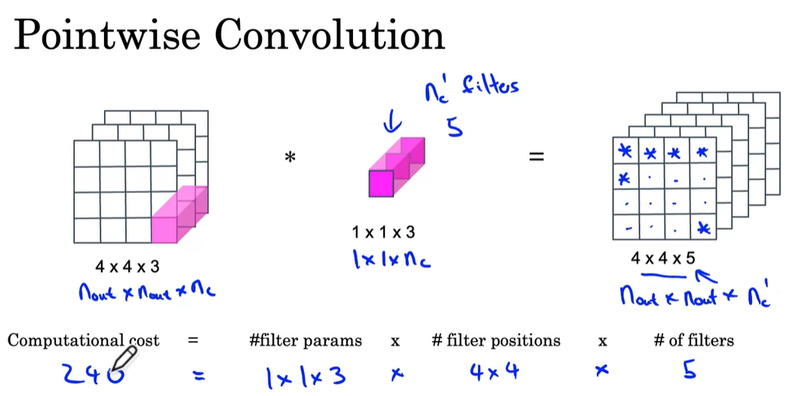
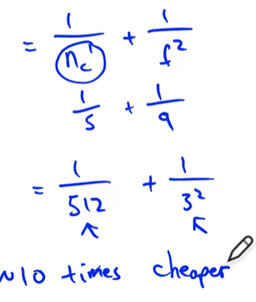

Slide 31
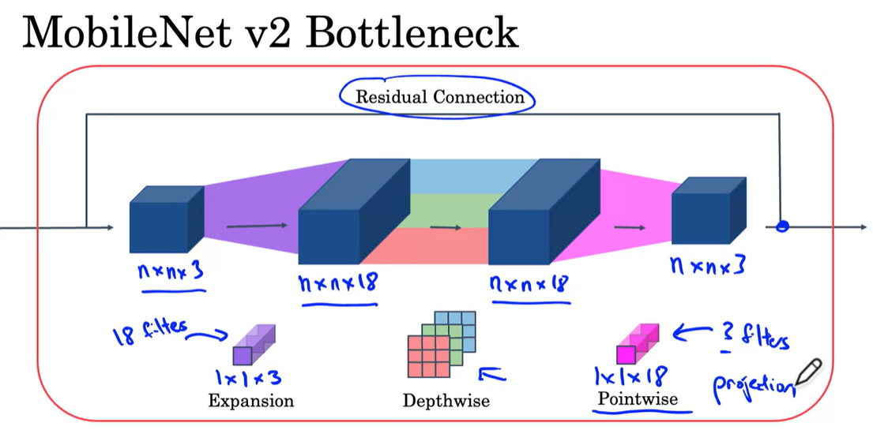

Slide 32
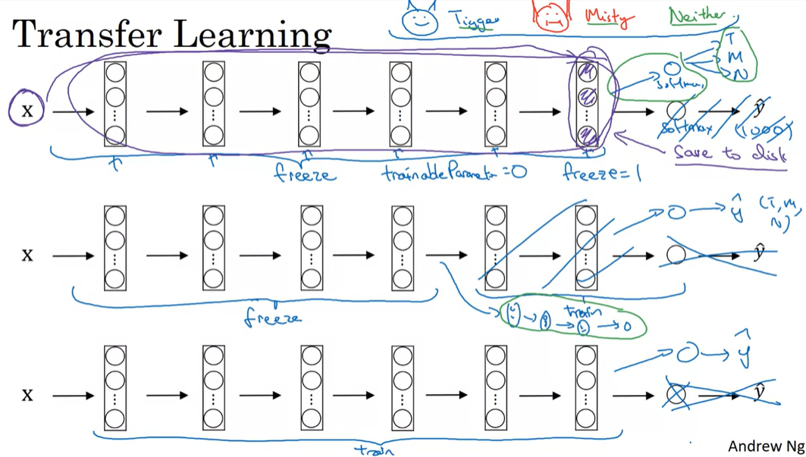
More data, more layers to train

Slide 33
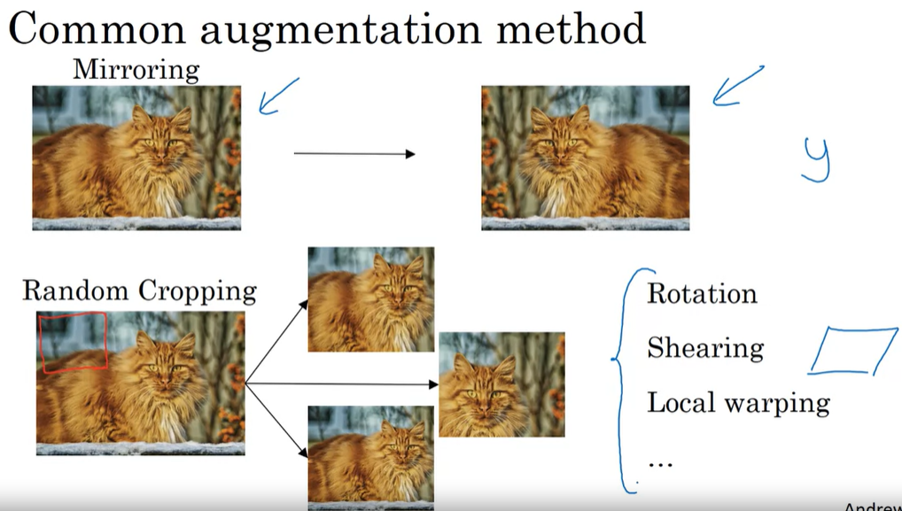

Slide 34
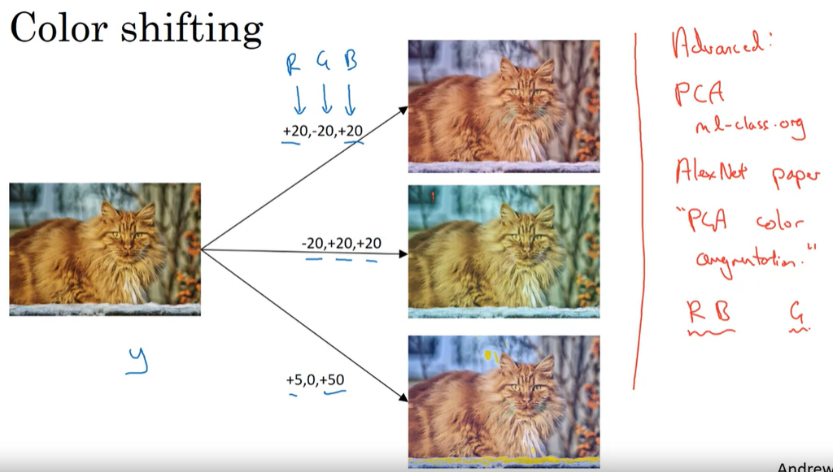

Slide 35
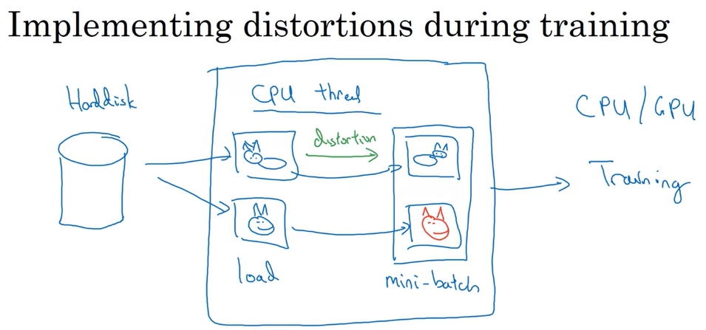


Run In Parallel

Slide 36
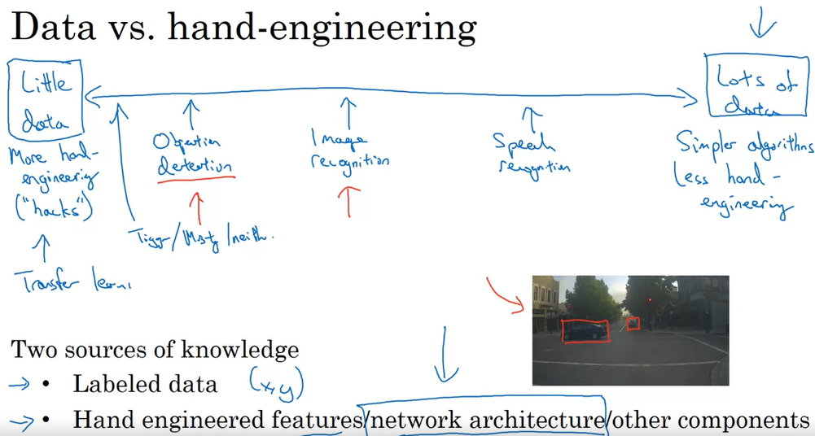

Slide 37
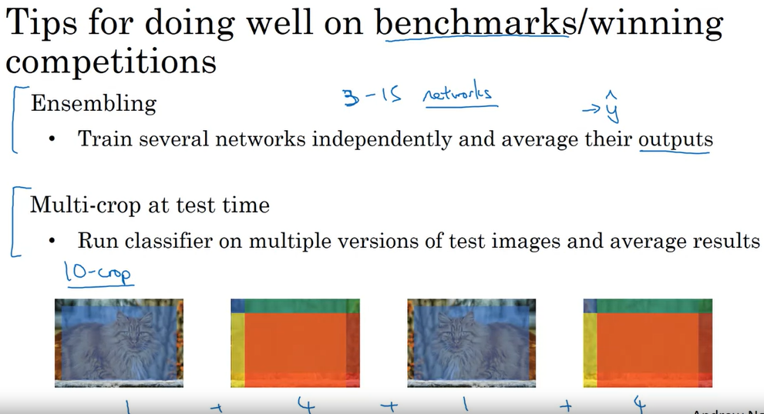

Slide 38
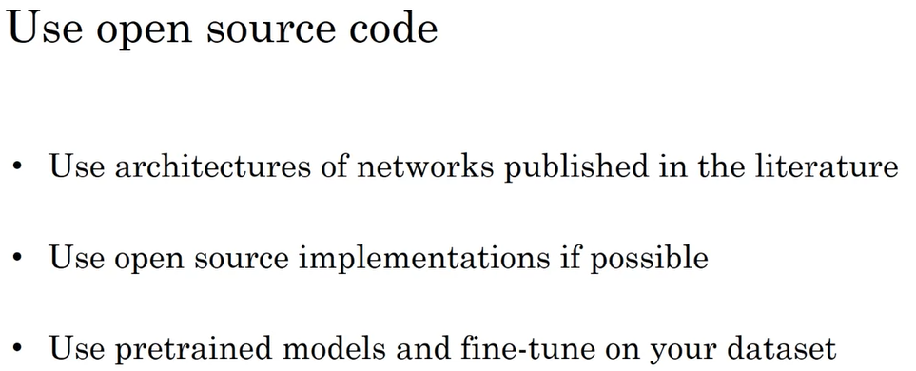

Slide 39
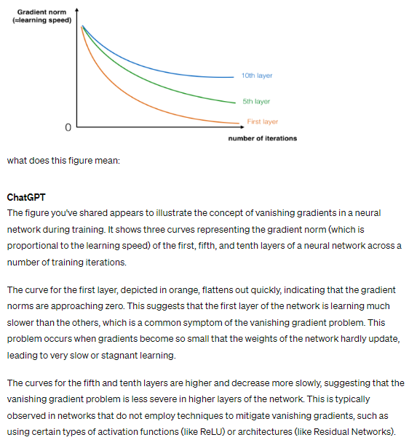

Slide 40
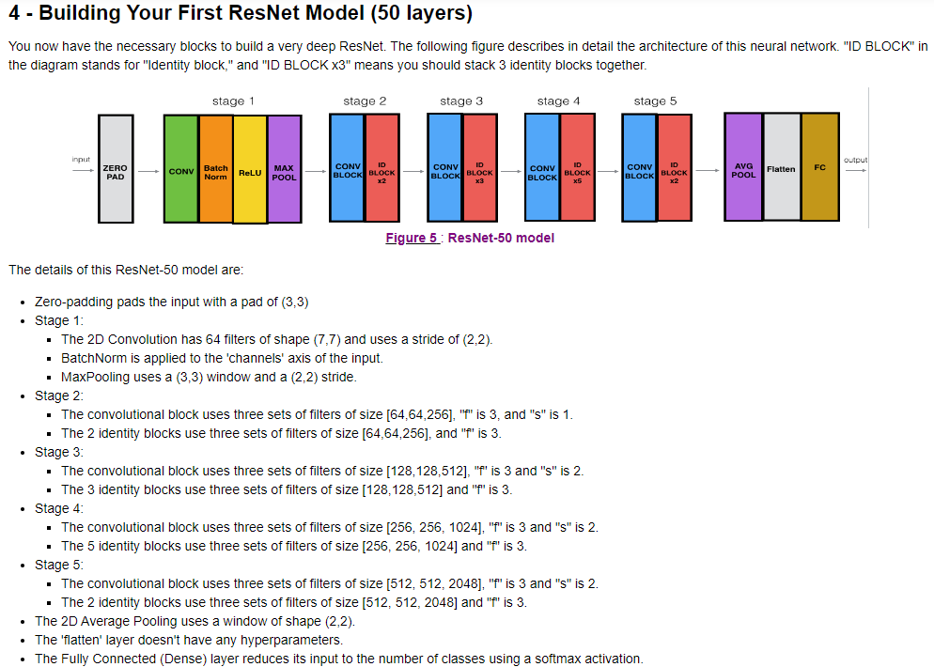

I added a same padding MaxPool at each identity block, and the performance is increased significantly.

Slide 41
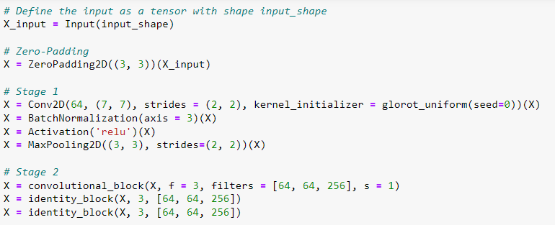

After stage 1, the output is 15, 15, 64
Conv block is used because 64 does not match 256
Identity block is used because 256 matches 256

Slide 42
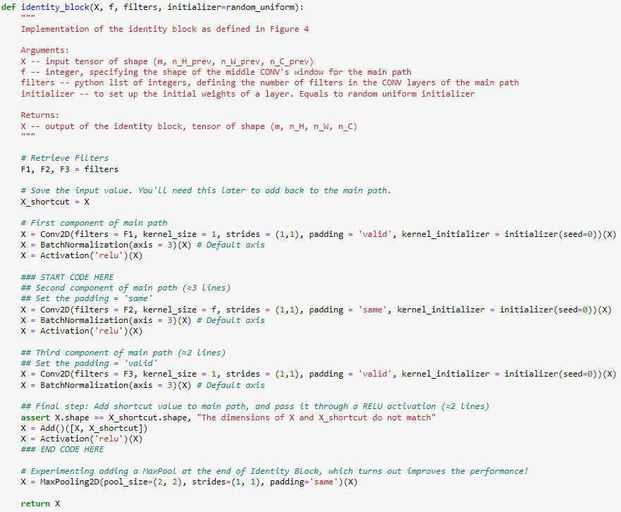
In the experiment, I modified the identity block by adding a same padding MaxPooling and the end, it attains 96.7% for 20 epochs, compare to without, which is 87.5%

Slide 43
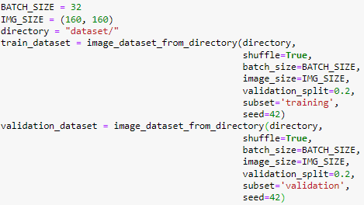

Train-Validation Split

Slide 44


Data Augmenter
Theoretically, augmenter can generate infinite images on the fly

